Slide 1



Item Response Theory in
Henrik Galligani Ræder
Doctoral Research Fellow

Slide 2


Slide 3

How would you measure height, if you couldn’t observe it?
Something that can’t be measured directly might still be measureable indirectly. Using indicators, we can use the commonality of the indicators to measure the unobservable variable we aim to measure.
Check out the measure yourself →
Notes:
https://nettskjema.no/a/156415

Slide 4
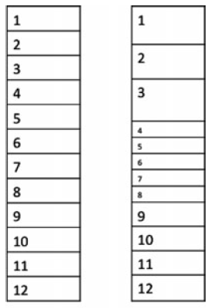

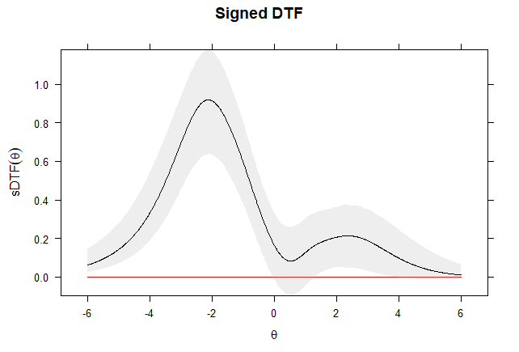


Outline
Item Response Theory
Comparing test results
Fair comparison
In case you missed it:
Height questionnaire →
Notes:
To do
Add SAT/ACT in first picture
Use a similar picture as the unequal scales in Briggs article for 2nd topic
Find picture for DIF
Path diagram for 4th topic
Add animations

Slide 5
What is Item Response Theory?
Item Response Theory (IRT) is a family of statistical measurement models.
These models aims to describe the relationship between a persons response on a given item and the underlying trait the item is used to measure.
In case you missed it:
Height questionnaire →
Notes:
IRT (also known as latent trait theory, strong true score theory, or modern mental test theory)
Underlying trait – latent variable – unobservable variable – construct – factor -
Item – comes from psychology,
Task – education
Other names, indicator

Slide 6
IRT advantages
Ability estimation is item independent given a sufficient item pool.
Measurement error provided conditioned on the latent trait level.
More detailed diagnostic information.
More flexible when comparing different measures.
+++
Notes:
It is possible to estimate an individual’s ability on the same
ability scale from any subset of items
The domain of items has to be homogeneous in the sense of
measuring a single ability: If the domain of items is too
heterogeneous, the ability estimates will have little meaning
Item response models provide a way of comparing examinees
even though they may have taken quite different subsets of
test items
There are two primary advantages of item response models:
1With many items that measure the same latent variable, the
estimate of an individual’s ability is independent of the
particular sample of test items that are administered to the
Individual
2A statistic indicating the precision with which each
individual’s ability is estimated is provided and this statistic
varies from one individual to the next

Slide 7
Where is IRT used?
Educational Measurement
Psychological Measurement
Health Measurement
Market research
Surveys
Cognitive diagnosis
…

Slide 8





IRT in education
International Large Scale Assessments (ILSAs)
  OECD
    PISA
    PIAAC
    +++
  IEA
    TIMSS
    PIRLS
    +++
  +++
National testing systems
  National Prøver
  ACT/SAT
  +++
+++
Notes:
Educational Monitoring
Comparable measures
High Stake Testing
Fairness

Slide 9
Most commonly used IRT models
Most common:
Rasch Models
2/3 Parameter Logstic Models
(Generalized) Partial Credit Models
Graded Response Model
Rating Scale Model
Used for dichotomous items, such as true/false, correct/incorrect.
Used for polytomous items, such as Likert scale, partial credit items or other ordinal responses.
Notes:
SHORT primer on different models.
Script (NB! Accurate info here)

Slide 10
Likert scale
A:
1. Strongly Disagree
2. Disagree
3. Agree
4. Strongly Agree
Vs.
B:
1. Disagree
2. Somewhat Disagree
3. Somewhat Agree
4. Agree
Sum score is often used to summarize scores on questionnaires using Likert Scales.
What is the distance on a latent trait continuum between response options?
C:
1. Disagree
2. Somewhat Disagree
3. Neither agree or disagree
4. Somewhat Agree
5. Agree
Notes:
In analysis such as factor analysis, Likert scale responses are often used as an approximation to a continuous variable, since it works fairly well. However, the choice of numeric value, and distance between the values, for the different options are rather arbitrary.
Both cases will look similar from a data point of view, but due to the severity of the response options, they mean something else. In option A, the numeric difference between Disagree and Agree is 1, while in option B it is 3. With IRT, we can get a none-arbitrary value for the difference between these options. In addition, a neutral response is often avoided to force a respondent to make a choice.

Slide 11
Other types of IRT models
Multidimensional models:
Reckase, M. D. (2009). Multidimensional item response theory models. Springer, New York, NY.
Explanatory models:
De Boeck, P., & Wilson, M. (2004). Explanatory item response models: A generalized linear and nonlinear approach. Springer Science & Business Media.
And many more:
van der Linden, Wim J., ed. Handbook of Item Response Theory: Volume 1: Models. CRC Press, 2016.
Notes:
To many to list here, but the following books can be consulted for an overview.

Slide 12
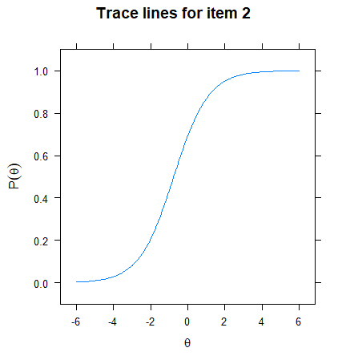




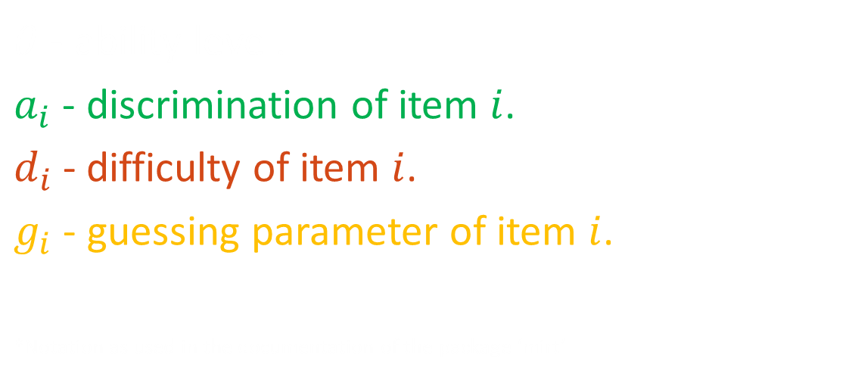
3-Parameter logistic model (3PL)
$$a_{i}$$
$$d_{i}$$
$$p_{i}\left(x=1 | θ, a_{i}, d_{i}, g_{i}\right)=g_{i}+\frac{1−g_{i}}{1+e^{−a_{i}\left(θ−d_{i}\right)}}$$
$$g_{i}$$
$θ$ - ability level.
$a_{i}$ - discrimination of item $i$.
$d_{i}$- difficulty of item $i$.
$g_{i}$ - guessing parameter of item $i$.
*Notation as used in the documentation of the package ‘mirt’
R-code to open interactive display for item plots using the shiny interface:
  ### Packages
  library(mirt)
  library(shiny)
  ### Shiny display
  itemplot(shiny = T)

Slide 13
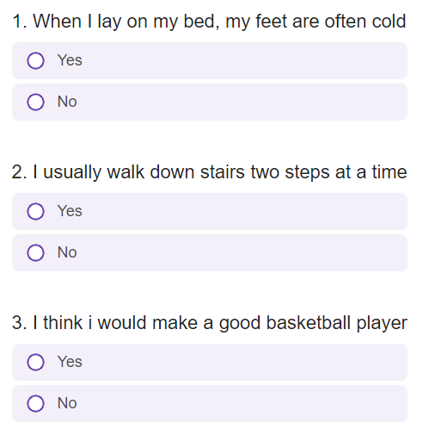
Modelling height using Item Response Theory
IRT package used:
  {mirt} – multidimensional item response theory
Data used:
Questionnaire measuring height:
  14 dichotomous items
  252 complete observations
  Self-reported height
Height questionnaire →

Slide 14
IRT vs CTT thought experiment
 | Item 1 | Item 2 | Item 3 | Item 4 | Item 5 | Item 6 | Item 7 | Sum
Student A | ✓ | ✗ | ✗ | ✗ | ✗ | ✗ | ✗ | 1
Student B | ✓ | ✓ | ✓ | ✗ | ✗ | ✗ | ✗ | 3
Student C | ✓ | ✓ | ✓ | ✓ | ✓ | ✗ | ✗ | 5
Student D | ✓ | ✓ | ✓ | ✓ | ✓ | ✓ | ✓ | 7
Notes:
If we just count the number of points, Student B is two points better than student A, Student C two points better than Student B and so on. The difference between Student A and B, B and C, and C and D looks like it is the same.

Slide 15

IRT vs CTT thought experiment
 | Item 1 | Item 2 | Item 3 | Item 4 | Item 5 | Item 6 | Item 7 | Sum
Student A | ✓ | ✗ | ✗ | ✗ | ✗ | ✗ | ✗ | 1
Student B | ✓ | ✓ | ✓ | ✗ | ✗ | ✗ | ✗ | 3
Student C | ✓ | ✓ | ✓ | ✓ | ✓ | ✗ | ✗ | 4
Student D | ✓ | ✓ | ✓ | ✓ | ✓ | ✓ | ✓ | 5
Notes:
What if we remove item 5 and 6 from the test, or replace them with harder items that none of the students are able to answer. Now the difference between student B/C/D is one point, while A and B is still 2 points. Is the difference between A and B twice as much as that of B and C or C and D?

Slide 16
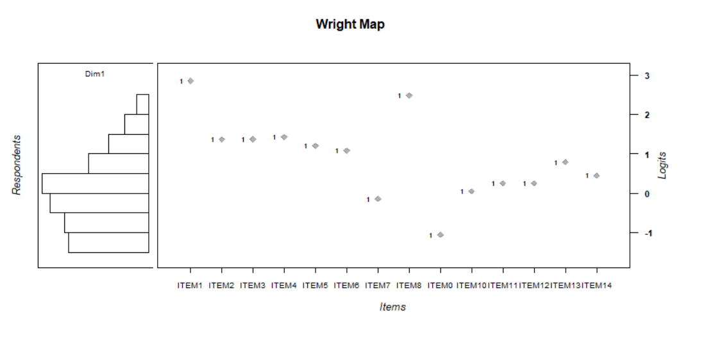
Wright Map
Notes:
Todo:
Add wright map
Content:
Wright map as a representation of an underlying scale, with profficiency and ability on the same scale. Lift weight methaphor?
Add a bit about standard setting and giving meaning to latent scales

Slide 17
What is required to use IRT?
Sample size larger than at least 100 depending on models used. Preferably more.
Computational power.
Note: The more complex the model is, the larger the sample needs to be for stable parameters.
Notes:
To do:
Add requierments
Computational power
Sample size
IRT assumptions

Slide 18
IRT also builds on a few assumptions
A single construct is measured.*
Local Independence
Correct type of response function.
*Not counting multidimensional models.
Notes:
Most IRT models are confirmatory, and as such, we need to prespecify the underlying dimensional structure prior to the analysis of a test. The model structure needs to correspond to the test-structure for it to be prudent to use said IRT model
Local independence in popular unidimensional models assumes a single dimension can explain all the assosciations between the items.

Slide 19

Comparing test results – Test equating
How can we compare the results on different tests?
?
=
Notes:
Todo:
Situations when we want to compare results
Remind of assumption of intervall properties of an IRT scale
Add 2 wright maps

Slide 20
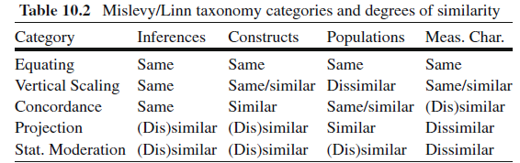
Types of test linking
Kolen, Michael J., and Robert L. Brennan. Test equating: Methods and practices. Springer Science & Business Media, 2013. p 499.
Notes:
Todo:
Equations and practical implementations

Slide 21
There are multiple methods, but concurrent calibration is one of the simplest to implement
Necessary with something shared, such as:
Some student’s taking multiple tests
Some items being shared between test-forms
Notes:
Linear transformations such as
mean – mean,
mean – sigma
Non-linear transformations such as

Slide 22
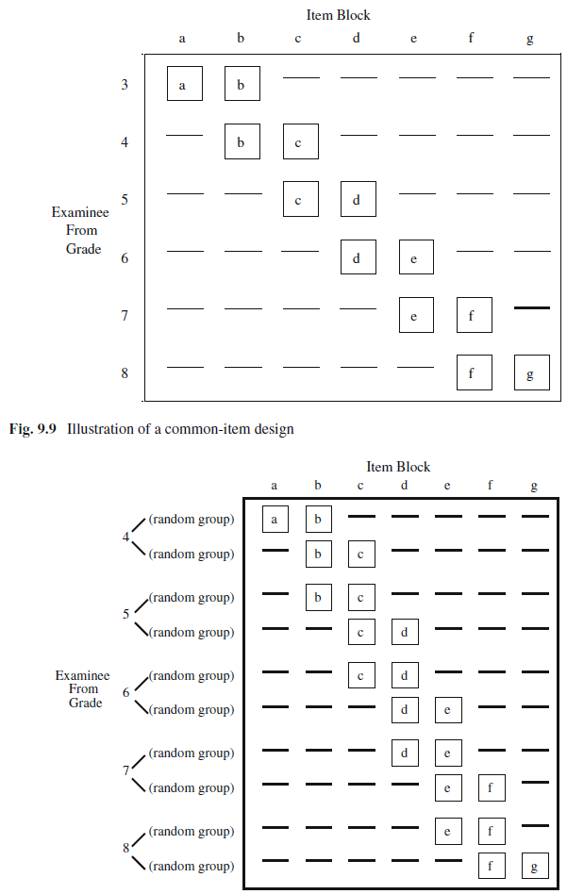
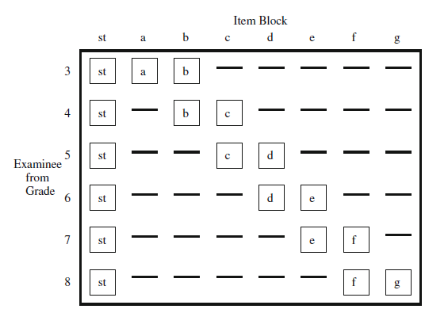
Typical implementations
Common Item
Equivalent Groups
Anchor test/Scale Test
… Or a combination, like the
popular non-equivalent
groups with Anchor test
design (NEAT)
Kolen, Michael J., and Robert L. Brennan. Test equating: Methods and practices. Springer Science & Business Media, 2013.
Notes:
Mention mean – mean, mean – sigma, but specify few validity checks available

Slide 23
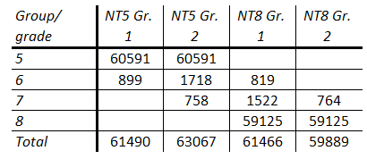
Test equating –Practical example
Ordinary implementation of
“Nasjonale Prøver i regning”

Slide 24
Test equating – Practical example
Extended data collection to
connect grade 5 and 8

Slide 25
Test equating –Practical example
Ordinary implementation of
“Nasjonale Prøver i regning”
Extended data collection to
connect grade 5 and 8

Slide 26
Test equating – Practical example
Data structure:
One group.
Two tests, three item blocks.
NT5 Gr. 2 shared (23 items).
Notes:
OPEN R STUDIO

Slide 27
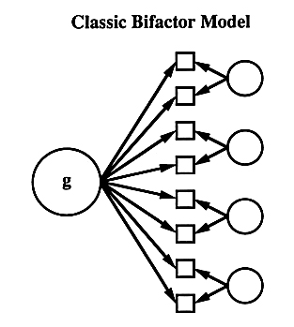
Does the tests compared test the same thing?
Parallel analysis
  Binary data requires a modified approach
Multidimensional models
  Bifactor
  Correlated simple structure
  ++
++

Slide 28
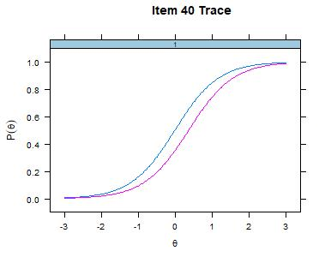
Test Fairness – Differential Item Functioning
An item, and by extension, a test, might measure differently, depending on the group tested.

Slide 29
There are many ways to investigate if an item is invariant across different groups.
Mantel-Haenszel
Wald statistic
Random-Effects Models
Logistic Regression Method
Likelihood-ratio test
++
[Go to picture folder]
Notes:
Measurment invariance = Parameter invariance

Slide 30
Differential Item Functioning – Practical example
Data structure:
Two groups.
One test.

Slide 31
Consequence of differential item functioning
Unfair comparisons between students
Systematic disenfranchisement of a minority
Notes:
Measurment invariance = Parameter invariance

Slide 32
Dealing with differential item functioning
Ignore items
Allow items to estimate freely across groups

Slide 33
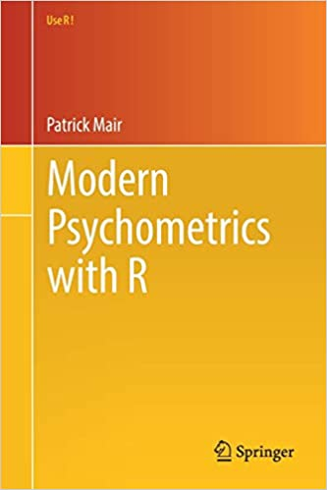


Thank you!
“Modern Psychometrics with R”
For R novices familiar with IRT
“Using R for Item Response Theory Model Application”
For R and IRT novices
For more information about the linking of the Norwegian national numeracy tests, see the QR code (report in Norwegian)

