Slide 1
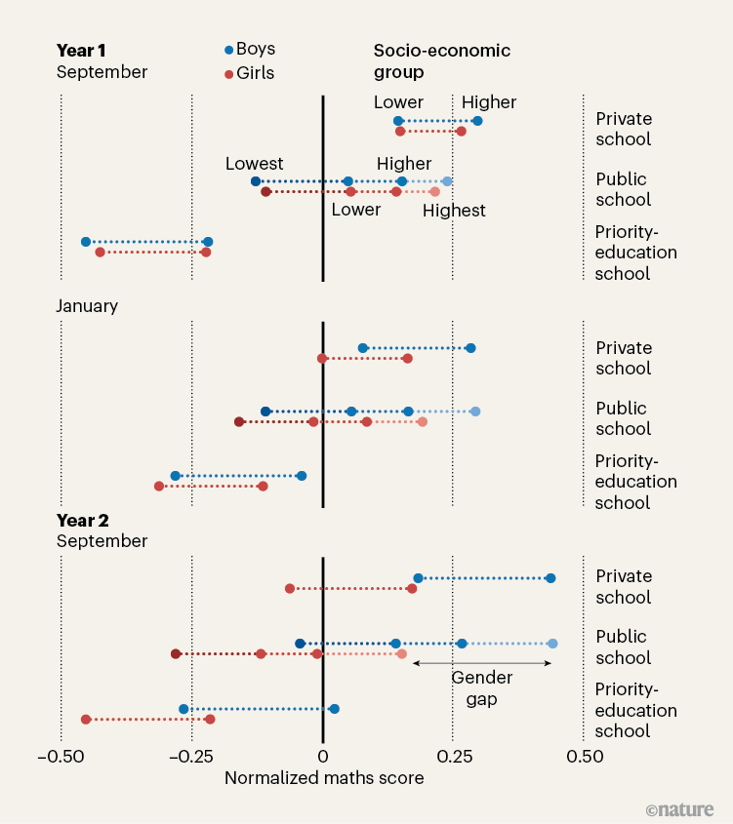





Boys surpass girls in
maths in the first year of school
Gender gap in math emerges after children start school, across schools and backgrounds
Nelly Dean¹, Hindley Earnshaw¹, Michael Johnson², William Jones²
University of Oslo¹, University of Manchester²
Introduction
Methods
  Gender inequalities in science, technology, and mathematics (STEM) remain a global concern, limiting innovation and perpetuating economic disparity. Although extensive meta-analyses have found little to no difference in mathematical ability between boys and girls , disparities appear later in education and are reflected in STEM career pathways. Understanding when these differences arise is critical for developing evidence-based educational policies. Using a uniquely large dataset from France, this study tracks the performance of more than 2.6 million children to pinpoint the precise moment when gender differences in mathematics achievement emerge.
The study analysed standardized mathematics test scores from cohorts of children aged 5–7 years between 2018 and 2022. Assessments were administered at three points: upon entry to the first school year (T1), four months later (T2), and at the start of the second year (T3). Data were stratified by gender, socio-economic quartiles, school type (public, priority-education, and private tuition-based schools), and region. Multilevel regression models were used to estimate mean differences and control for covariates such as age, parental education levels, living area, and family structure. High achievers were defined as pupils performing in the top 10% and top 5% nationally at T3.
Results
At the highest performance levels, 10.2% of boys but only 6.1% of girls reached the top decile, and boys were nearly twice as likely to fall within the top 5% (5.4% vs. 2.8%). The pattern was consistent across all socio-economic quartiles and school types, with average gaps ranging from 1.6 to 2.2 points
Across school types, differences were remarkably stable, with private, standard public,
and priority-education schools all showing gaps within the 1.8–2.1 point range. Regional analyses indicated minimal variation, with standard deviations of the gender gap across regions below 0.5 points, confirming the near-universal character of the phenomenon. Examination of distributional outcomes revealed that at T3, boys were disproportionately represented among high achievers: 10.2% of boys versus 6.1% of girls achieved scores in the top decile, while 5.4% of boys compared to 2.8% of girls reached the top 5%. At baseline (T1), mean mathematics scores did not differ significantly between boys (M = 52.0, SD = 9.4) and girls (M = 52.0, SD = 9.6), t(1,350,000) = 0.81, p = .42, d = 0.01.
Conclusions
The gender gap in mathematics emerges during the first year of schooling, despite equivalent performance at school entry. This pattern was robust across socio-economic, regional, and institutional subgroups, suggesting systemic drivers rather than individual or family-level factors. Early divergence in high-achieving groups raises concerns for long-term STEM participation. These findings highlight the need for classroom-level interventions targeting teacher expectations, assessment practices, and gender stereotypes, alongside longitudinal research to identify causal mechanisms.
Future Research Needed
Future research should seek to elucidate causal mechanisms, including the role
of teacher expectations, implicit gender biases in instructional materials, and parental reinforcement of gendered academic identities. Longitudinal cross-national studies will be essential to determine the generalizability of the French findings. Identifying the drivers of early divergence is essential for designing interventions.
Figure 1 | Emergence of a gender gap in mathematics. Children in France take a set of maths exams at the beginning of their first year of school in September, four months later and at the beginning of their second yearMartinot et al.²
Fryer, R. G. Jr & Levitt, S. D. Am. Econ. J. Appl. Econ. 2, 210–240 (2010).
Martinot, P. et al. Nature 643, 1020–1029 (2025).
Karna, U., Lee, M. S., List, J. A., Simon, A. & Uchida, H. Nature 639, 976–984 (2025).
Fischer, J.-P. & Thierry, X. Br. J. Dev. Psychol. 40, 504–519 (2022).
List, J. A. Experimental Economics: Theory and Practice (Univ. Chicago Press).
Dhuey, E., Figlio, D., Karbownik, K. & Roth, J. J. Policy Anal. Mgmt 38, 538–578 (2019).
SCAN HERE
for more information about the research or get in touch
Notes:
https://www.staffnet.manchester.ac.uk/brand/visual-identity/logo/logo-downloads/

